Slide 1
Week 3

Slide 2
Spelling Correction
Basic Principles
Choose “Nearest “ one for misspelled query term.
If two queries are tied , select the one more common
Term occurrence
Computational proximity of algorithms:
Take all correct spelled version of query,
only when term is not in dictionary
Returned results of query are fewer than present in documents.
If fewer document returned for query, then spell suggestion to user. respond “Did you mean ….?”
Forms of Spelling Correction
Isolated-term correction: single term at a time.
Context-sensitive correction: “Flew form Heathrow”

Slide 3
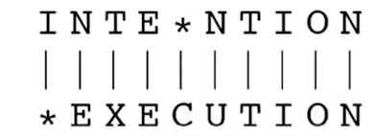
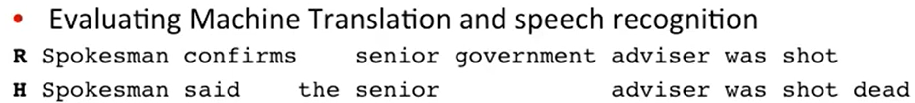
Edit Distance
Applications: Spell correction, computational biology, machine translation, speech recognition
Example :User typed “graffe”
Which is closest? Graf, graft, grail, giraffe
Minimum number of edit operations required to transform String1 to string2.
Insert a character into string or
Delete a character from string or
Substitution a character of the string by another character .
Also known as Levenshtein distance.

Slide 4
Minimum edit distance as Search
Space of all edit sequences is huge
we can not afford to navigate naively
Lots of distinct path's wind up at the same state
We don’t have to keep track of all of them
Just the shortest path to each of those revisited states.

Slide 5
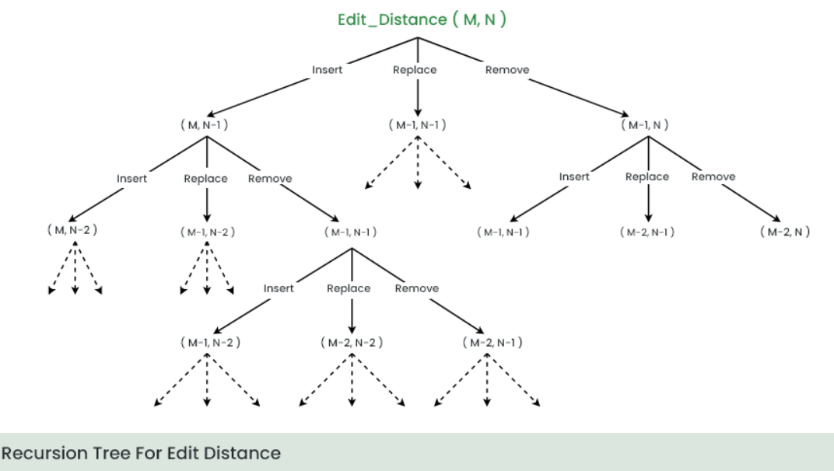
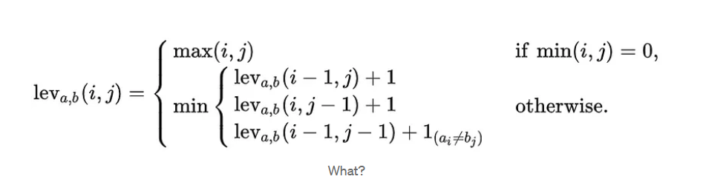
Search Space: Edit Distance
Dynamic Programming for shortest path :
Solving problems by combining solutions to subproblems.

Slide 6
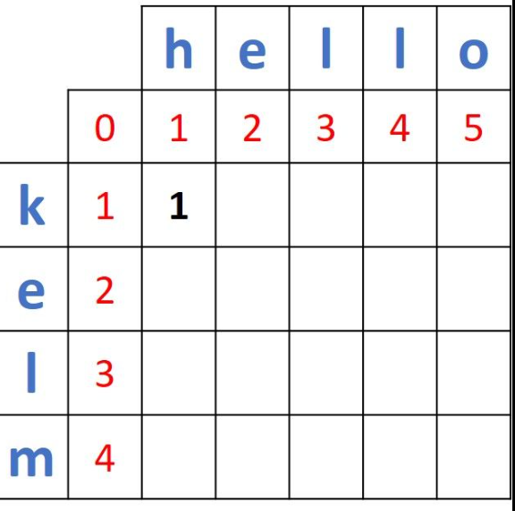
Task
str1 = "kitten" str2 = "sitting":

Slide 7
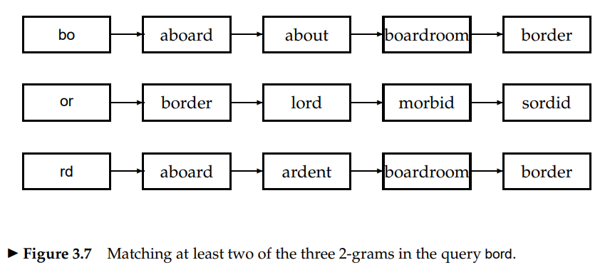
K-Gram Indexes for Spelling Correction
Assumption
Two terms within a small edit distance have many k-gram in common
Example: 3gram
Computer, cmputer, terran
Computer , route

Slide 8
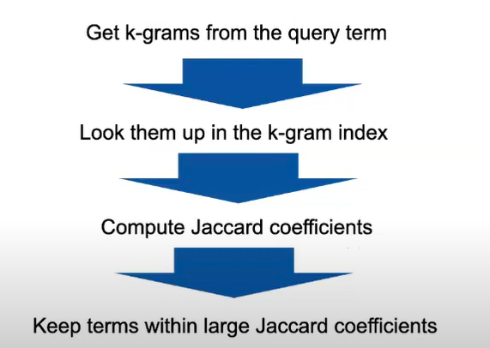
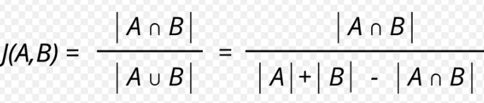
Jaccard Coefficients

Slide 9
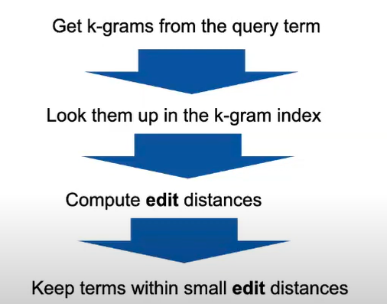
Updated

Slide 10
Context Sensitive Spelling Correction
Hostel Task :
A context sensitive real-time Spell Checker with language adaptability Prabhakar Gupta Amazon prabhgup@amazon.com

Slide 11
Task
Consider the following documents in a collection. Where in and of are treated as stop words.
Doc 1: multi label classification text
Doc 2: text classification in python
Doc 3: label of text in classification
Doc 4: classification of label in text
Query: label text classification
By Assuming a Boolean Model for information retrieval, how would you retrieve the relevant documents for the query form given collection? You can use Jaccard similarity for computing relevance between document and query.

Slide 12
Context sensitive Spell correction
Isolated criteria with edit distance
Working: Retrieve dictionary terms (isolated techniques) close (spelling correction) to each query term. W1, w2,w3 etc.
Flew from heathrow
Fled form heathrow
Flea form heathrow
Combinatoric for spelling suggestion:
Suggestion for flew= 7, 3 for heathrow, and 19 for form. How many corrected phrase will enumerate ?
Hit Based Spelling Correction:
How many times phrase appear in corpus?
Check hits in either in corpus or in query logs (past queries)(user feedback)
Enumerate the first term suggestion and then get the query which occurred most

Slide 13
Probabilistic Language Models
Assign a probability to a sentence or sequence of words
Machine Translation
Spell Correction
Example: The office is about fifteen minuets from my house
P(about fifteen minutes from)> P(about fifteen minuets from )
P(W)= P(w1,w2,w3….wn)
Relatively, the probability of an upcoming word:
P(w5|w1, w2, w3, w4)
The model which computes either of this equation is called Language Model

Slide 14
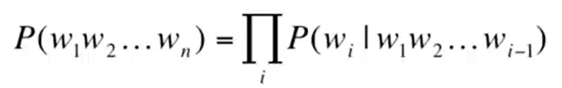
Compute Joint Probability: Chain Rule
Conditional probability equation
Chain rule in General:
P(“its water is so transparent”)

Slide 15
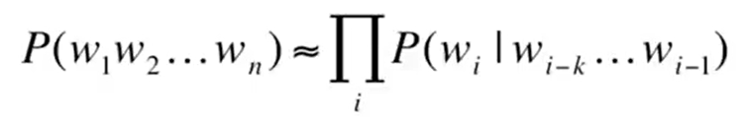
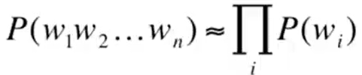

Estimating Probabilities: Markov Assumption
Simplifying assumption: Estimate the probability to the closer few Previous or couple of previous terms than the entire context
Unigram Model
Bigram Model
N-Gram Model: extend to trigrams, 4-grams and 5 grams
Problem: long-distance dependencies in language:
Example: “ the computer which I had just put into the machine room on the fifth floor crashed”

Slide 16
Phonetic Correction : Hostel task

